Slide 1
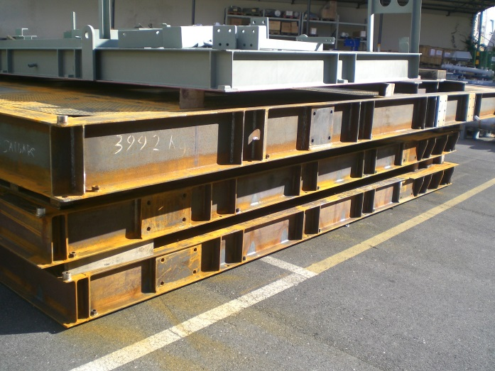
HS&E INCIDENT BULLETIN |  | 1st half year 2014
Location Country | Type of incident (example: Slip-Trip, Fall from Height, Vehicle , Laceration, Chemical Exposure)
Summary: | Two baseplates lower without plates for slinging loads
Problems during lifting of an heavy device, not correctly equipped for lifting operation
Root Causes: | Actions Taken Thus Far: Next Steps
Lack of training of technical staff Ineffective control of design | Ensure continuous training to personnel Issue dedicated check-list to facilitate controls by draftsman of details with potential impact on safety

